Slide 1
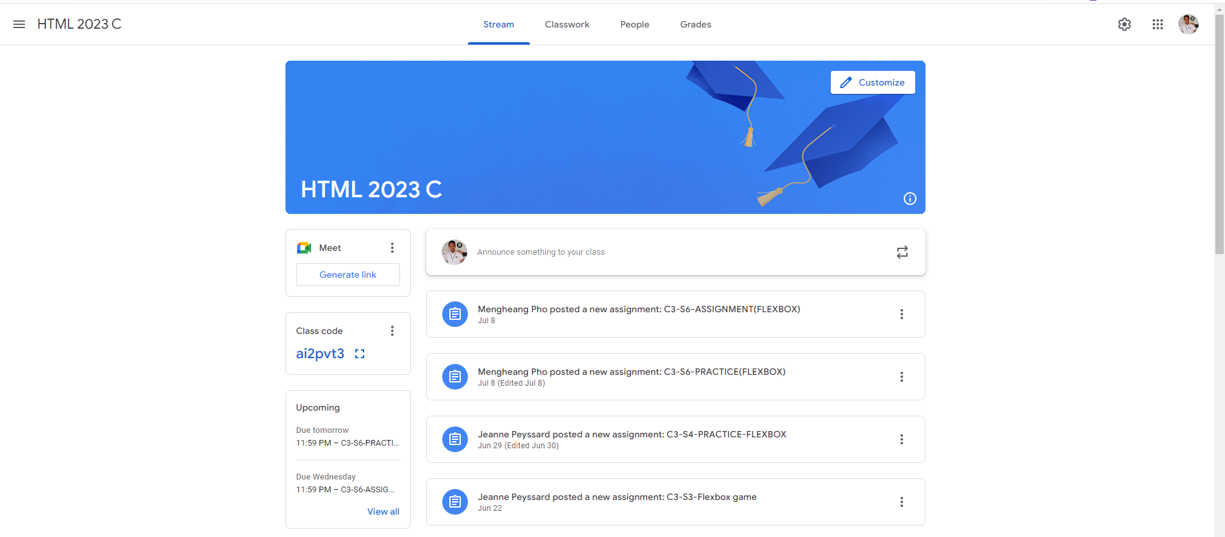
Identify root components of website below

Slide 2
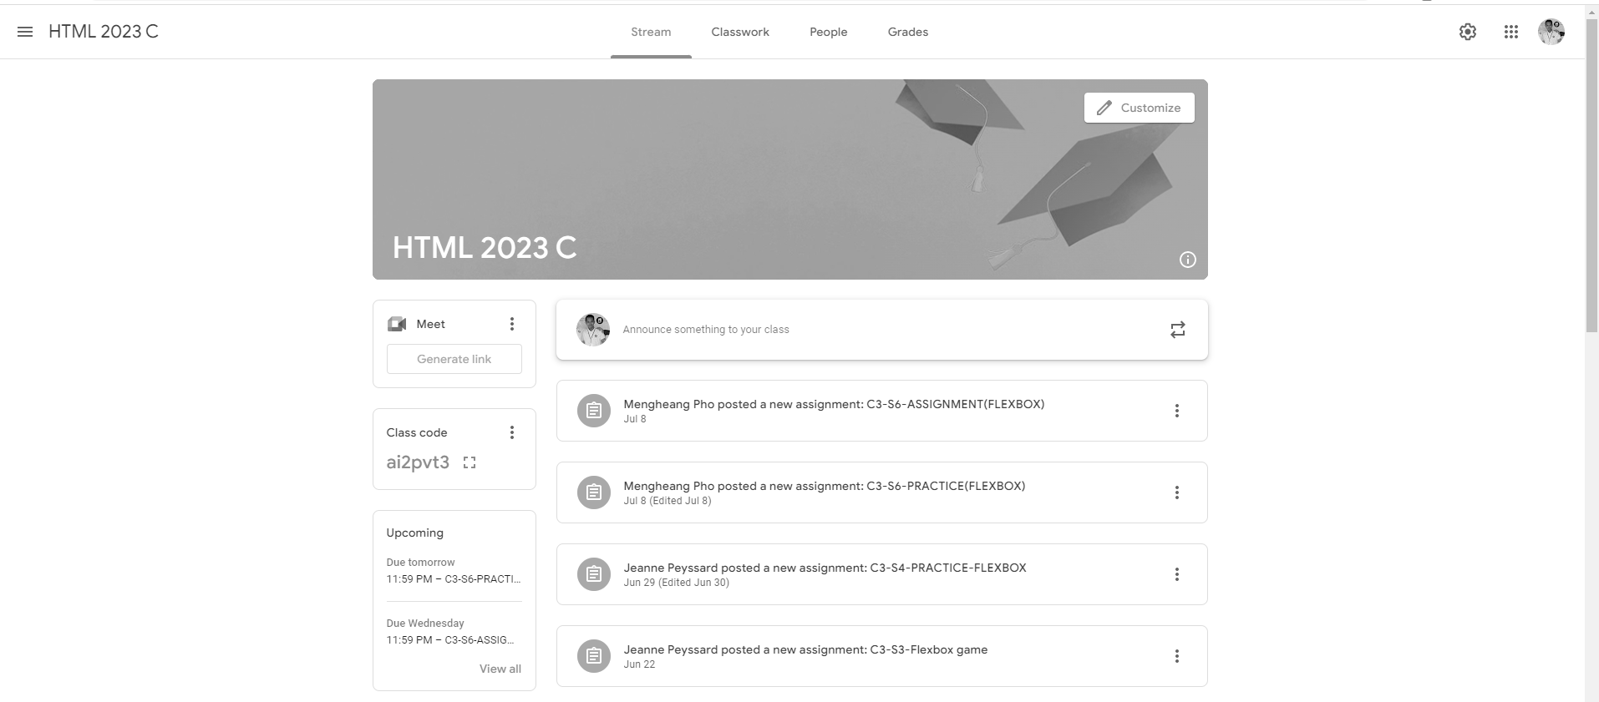
Flex-direction: column;
Nav
Main

Slide 3
Nav-left
Nav-middle
Nav-end
Justify-content:space-between;

Slide 5
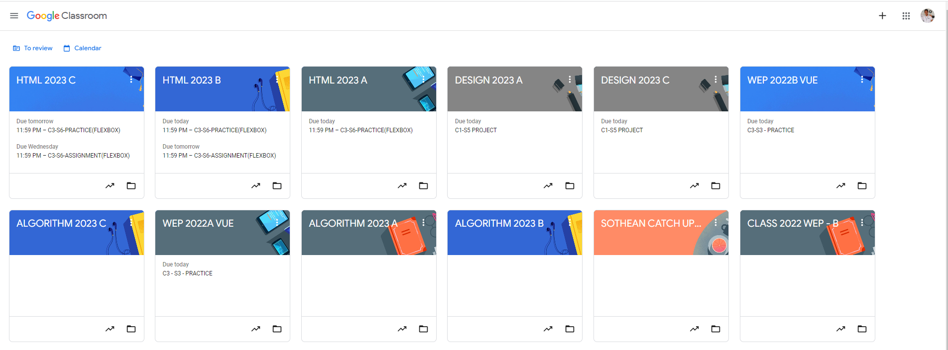
Root div
Height: 100vh;
flex-direction: column;
content
nav
Flex: 0
header
Flex: 0
Flex: 1

Slide 6
-justify-content: space-between;

Slide 7
Justify-contents: start-flex;
flex-direction: row;
Align-items: center;
Flex: 0
Flex: 1

Slide 8
Root content
Display: flex;
flex-direction: row;
Flex-wrap: wrap;
Gap:1rem;

